Slide 1
Web Programming Final Project
Course: Web Programming - Presented to Professor Abolghasem Sadeghi-Niaraki
09/06/2025
DD/MM/YYYY
Feature Name/Product
Your Company Name

Slide 2
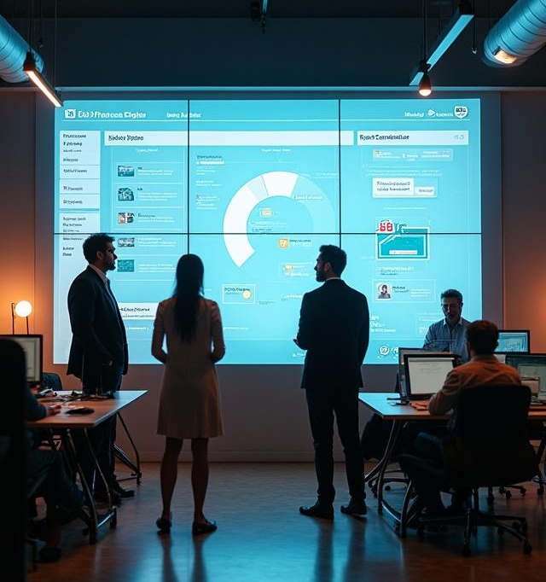
Meet the Team – Web Weavers
Maruf | Team Leader
Sarra | FullStack dev
Hasan | Frontend dev
Leuza | Backend dev
DD/MM/YYYY
Feature Name/Product
Your Company Name

Slide 3
01
Project Overview

Slide 4
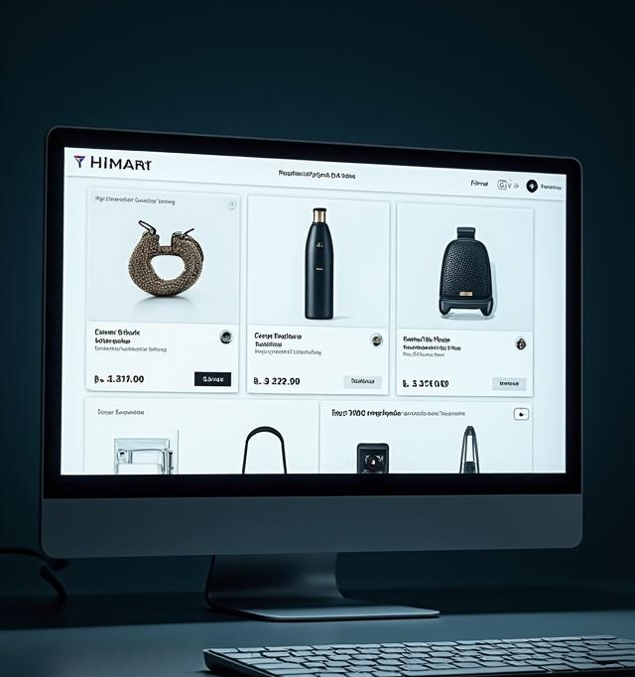
HiMart
The project is named HiMart, an innovative e-commerce web application designed to enhance user experience through a full-stack development approach.
DD/MM/YYYY
Feature Name/Product
Your Company Name

Slide 5
Project Description
HiMart offers a seamless shopping experience featuring user management, product handling, secure authentication, and a personalized interface, mimicking real-world e-commerce systems.
DD/MM/YYYY
Feature Name/Product
Your Company Name

Slide 6
Project Goals
The primary goals of HiMart are to apply comprehensive full-stack development skills, gain insights into real-life e-commerce systems, implement modern UI/UX practices, and enhance teamwork through collaborative project execution.
DD/MM/YYYY
Feature Name/Product
Your Company Name

Slide 7
02
Key Features

Slide 8

Dark Mode and Responsive Design
HiMart supports a Dark Mode feature for comfortable viewing in low-light conditions, ensuring an optimal user experience across various devices with a fully responsive design that adapts seamlessly to different screen sizes.
DD/MM/YYYY
Feature Name/Product
Your Company Name

Slide 9
User Authentication and Product Search
The application offers secure login options, including credentials and Google authentication. Additionally, it allows users to search products.
DD/MM/YYYY
Feature Name/Product
Your Company Name

Slide 10
Modern UI and Experience
HiMart features a modern, interactive UI designed to enhance user engagement, offering functionalities such as product search, persistent cart management, and real-time feedback on user actions to create an intuitive shopping experience.
DD/MM/YYYY
Feature Name/Product
Your Company Name

Slide 11
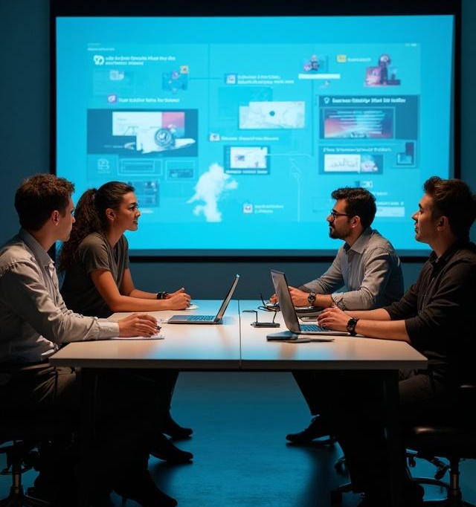
Sum Up
• Dark Mode Support (with visual)
• Product Search
• Cookie based Session Handling
• Fully Responsive Design (with visual)
• Login with Credentials or Google
• Persistent Cart
• Become a Seller
• Separate Seller Dashboard
• Auto Redirect to 404 / Unauthorized Pages
• Hosted Live on Vercel
• Modern, Interactive UI
• Real-life e-commerce-like experience
DD/MM/YYYY
Feature Name/Product
Your Company Name

Slide 12
03
Front/Back Technologies

Slide 13
Frameworks & Libraries:
• Axios
• Framer Motion
• Headless UI
• React + Vite
• React Chartjs 2
• React Dropzone
• React Hook Form
• React Icons
• React Toastify
• Tailwind CSS
DD/MM/YYYY
Feature Name/Product
Your Company Name

Slide 14
Backend & Database Technologies
• Node.js, Express.js
• Firebase (Authentication & Hosting)
• JSON Web Tokens (JWT)
• Bcrypt (Password Hashing)
DD/MM/YYYY
Feature Name/Product
Your Company Name

Slide 15
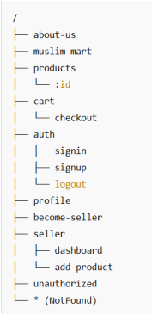
Project Structure
API Routes:
• GET /api/products
• POST /api/auth/signup
• POST /api/auth/login
• GET /api/user/cart
• ...and more
DD/MM/YYYY
Feature Name/Product
Your Company Name

Slide 16
03
Screenshots

Slide 17
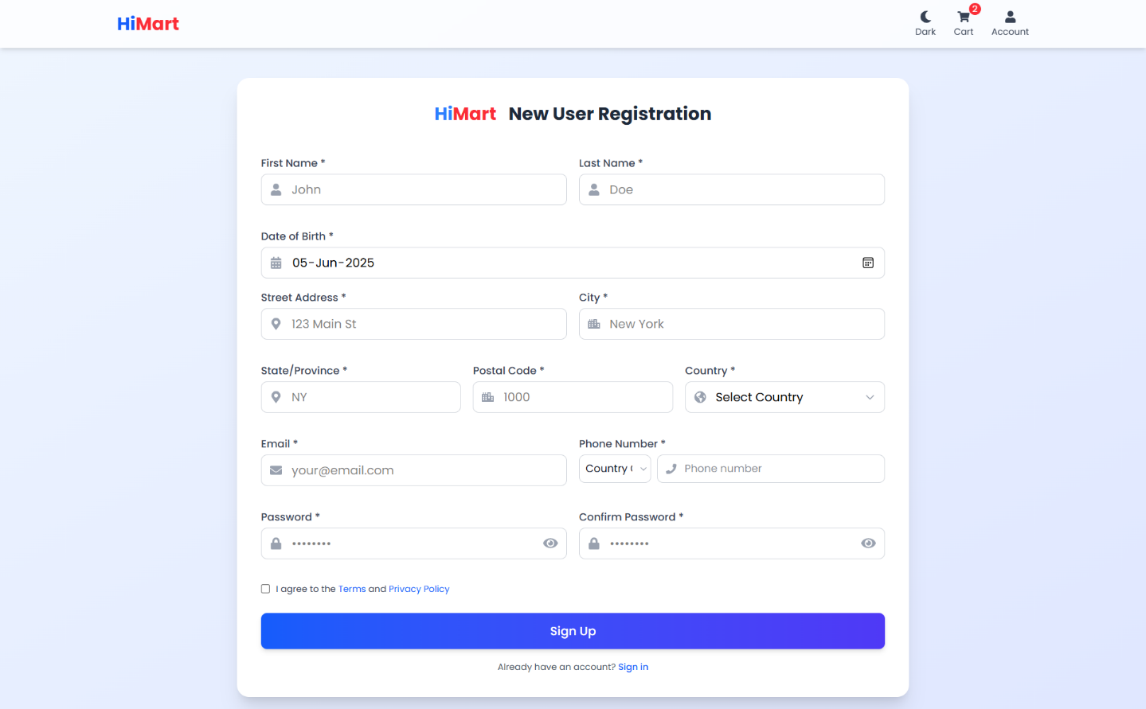
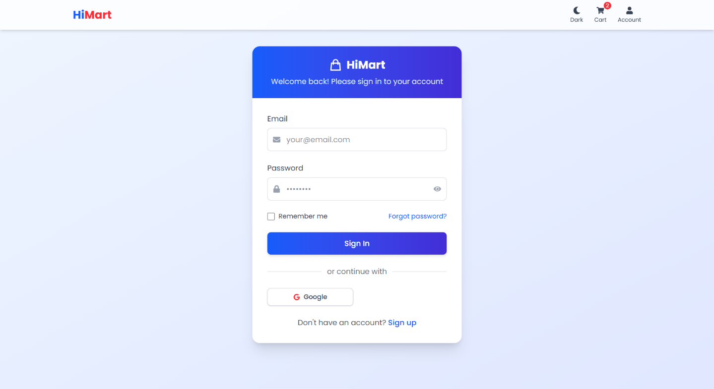
Login and SignUp

Slide 18
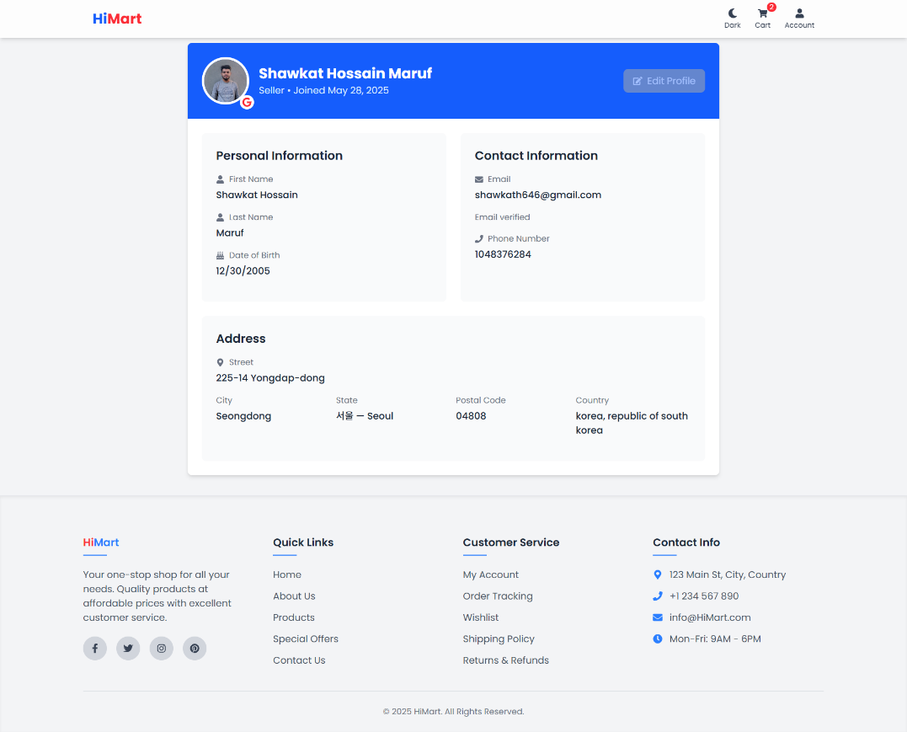
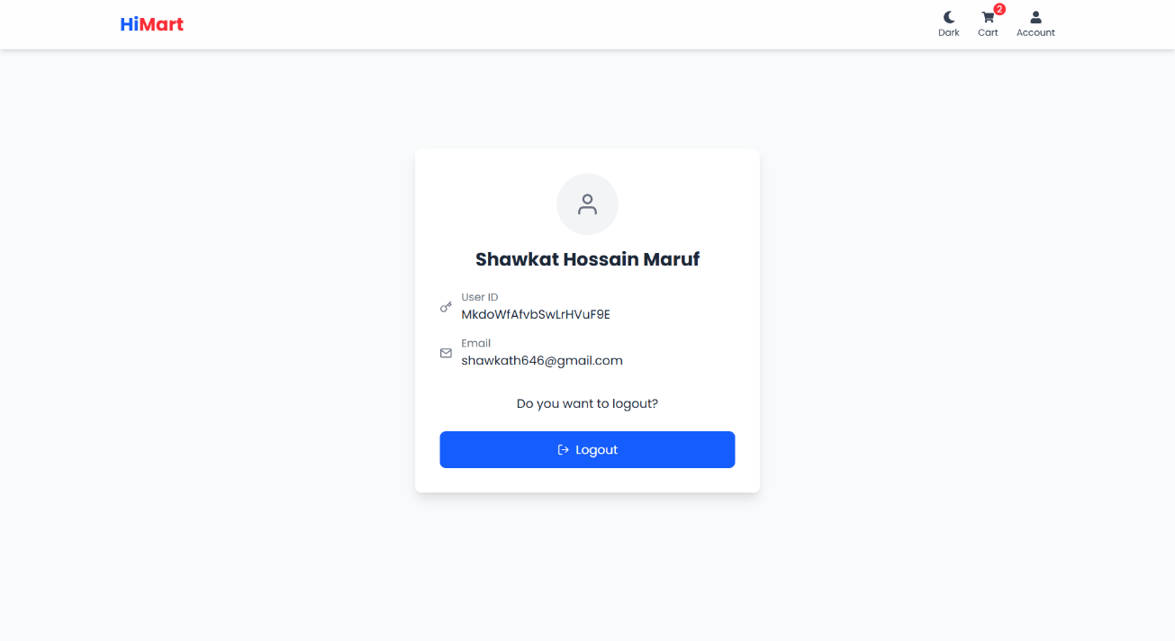
Profile & Logout

Slide 19
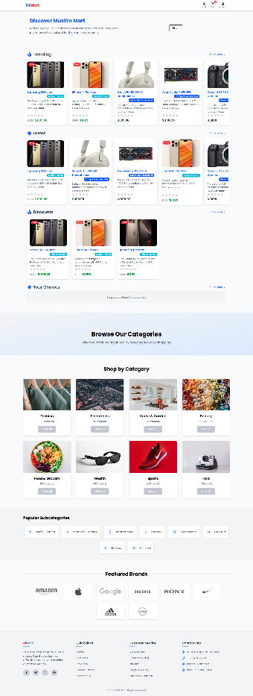
All Products Pages

Slide 20
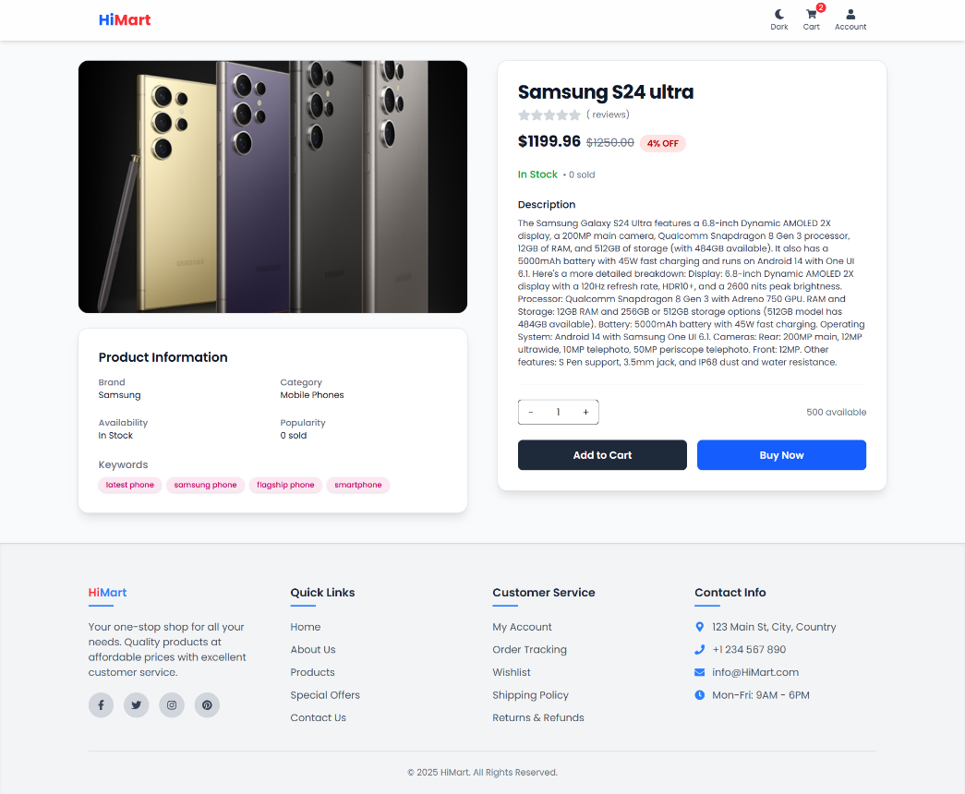
Products Pages

Slide 21
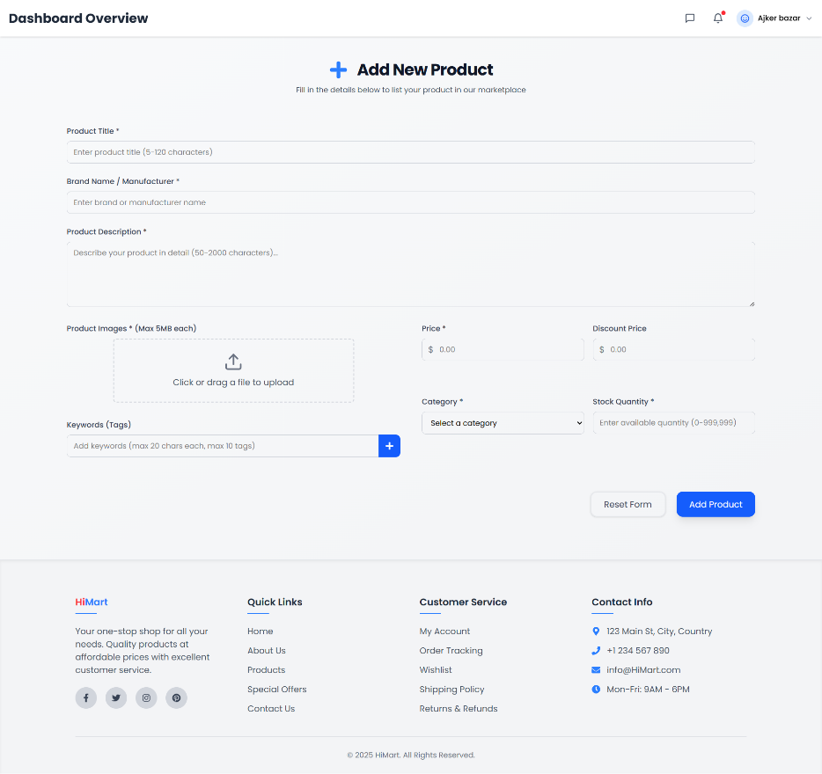
Product View

Slide 22
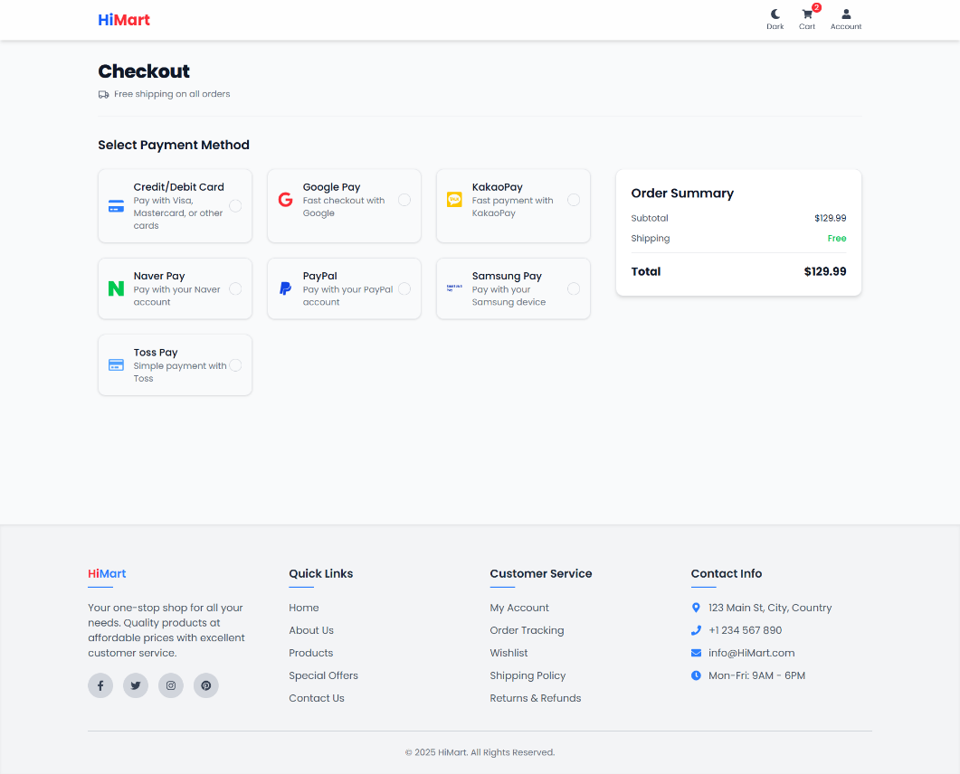
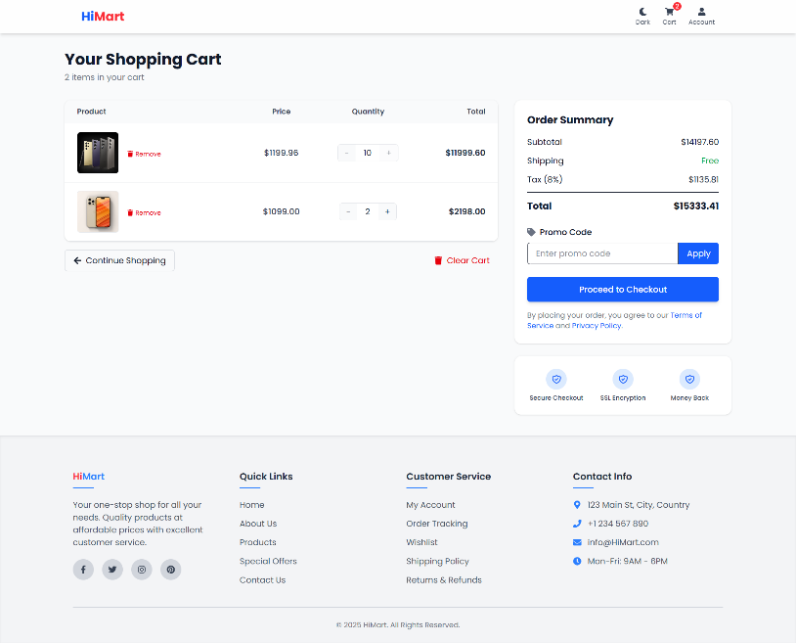
Cart & Checkout

Slide 23
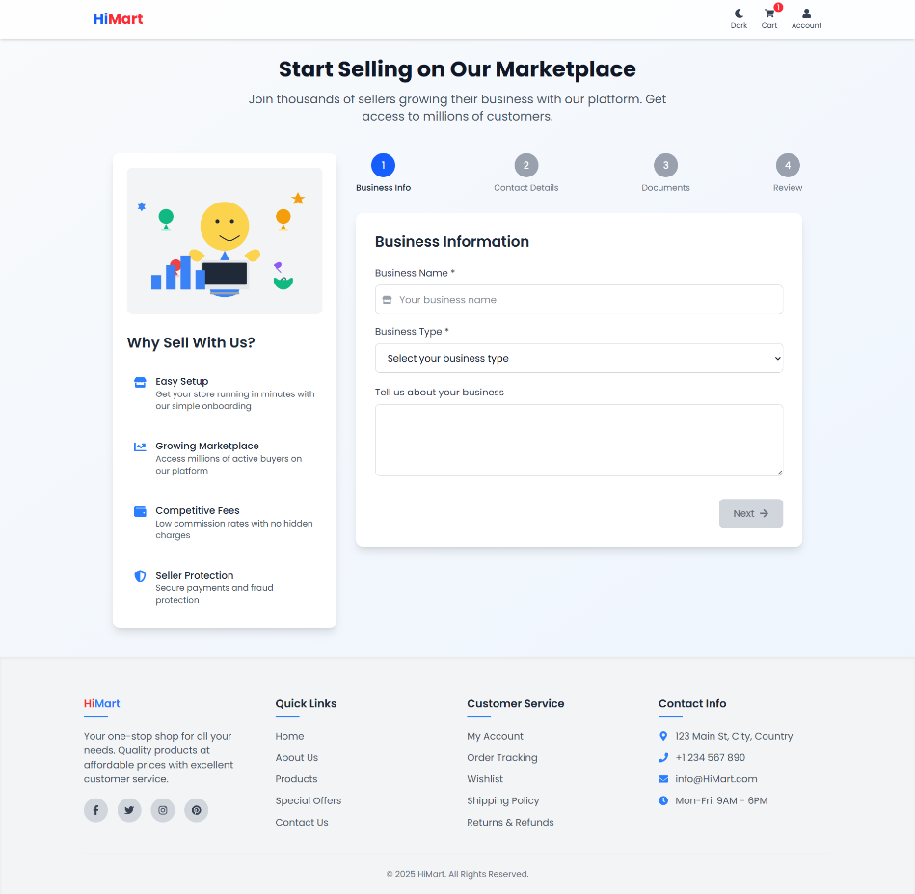
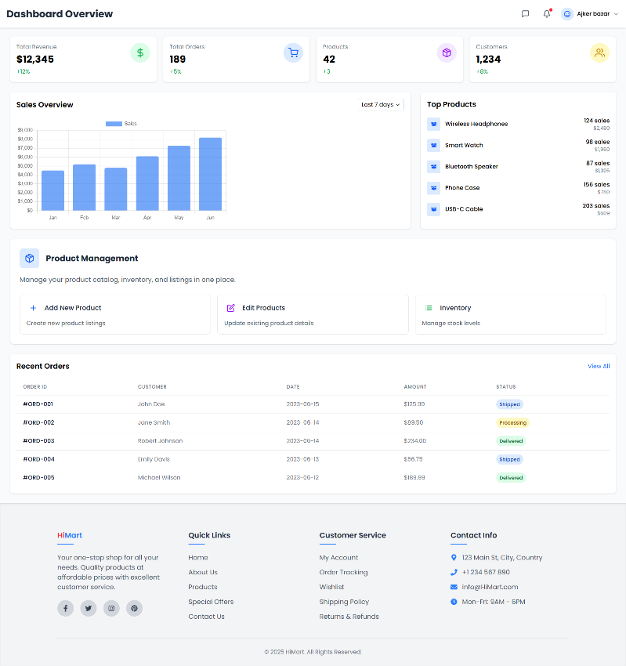
Become a seller & Seller Dashboard

Slide 24
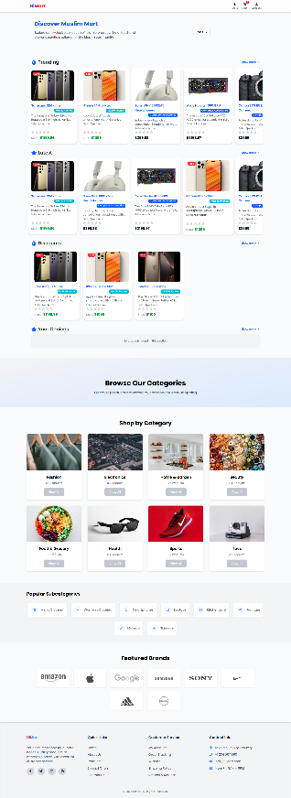
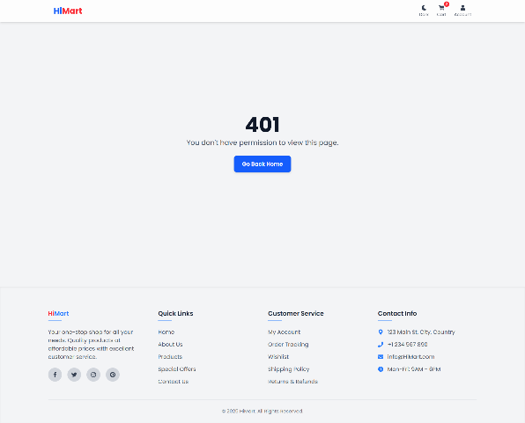
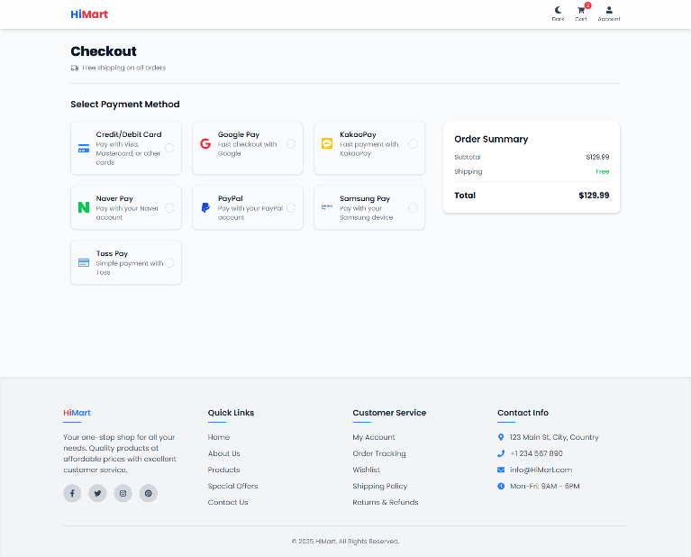
Extra Features

Slide 25
Thank you!
Do you have any questions?
+00 000 000 000
DD/MM/YYYY
www.yourwebsite.com
Your Company Name

